Slide 1


- An Automated system for real-time smart street light and efficient maintenance in cities.
INTELLILIGHT
Presented by :
RESHMA A- 210701211
RESHMA S - 210701213

Slide 2

1 | INTRODUCTION
2 | OBJECTIVE
3 | COMPONENTS
AGENDA
4 | CIRCUIT DIAGRAM
5 | RESULTS
6 | CONCLUSION
FUTURE SCOPE
7

Slide 3

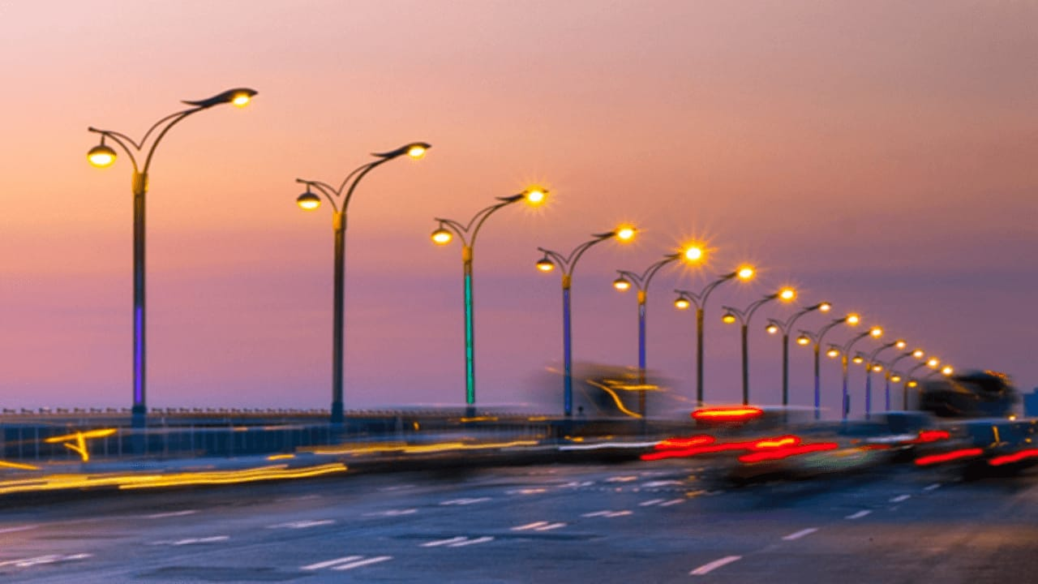

INTRODUCTION
Traditional lighting systems lack automation and remote control, leading to inefficient energy usage.
Manual operation of lights can be inconvenient and does not leverage sensor data for optimal functionality
So to overcome this our project aims to develop a smart lighting system that integrates LDR and IR sensors with Blynk for efficient and automated light control.

Slide 4



OBJECTIVES
Goal 1
Goal 2
Goal 3
Enhance Energy Efficiency
Remote Monitoring and Control
Increase efficiency and Convenience
Goal 4
User-Friendly Interface

Slide 5
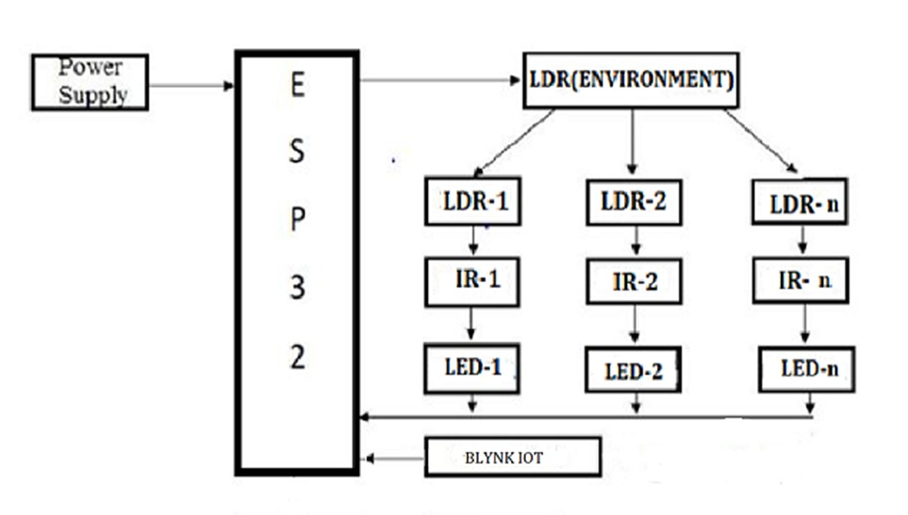
SYSTEM ARCHITECTURE
<
>

Slide 6
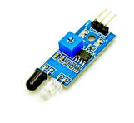
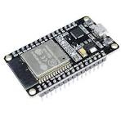
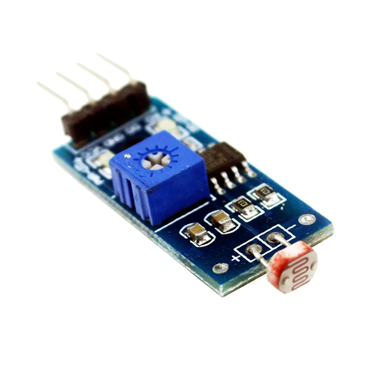
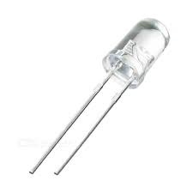
HARDWARES INVOLVED
IR Sensor
ESP32
LDR
LED

Slide 7


SOFTWARES INVOLVED
BLYNK IOT
ARDUINO IDE

Slide 8
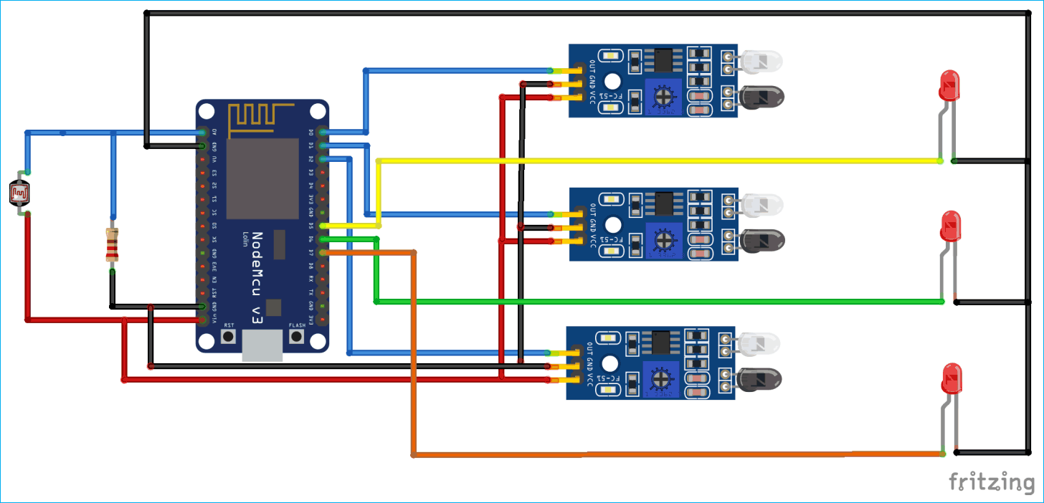
CIRCUIT DIAGRAM
LED 1
ESP32
IR 1
LDR
LED 2
IR 2
LED 3
IR 3

Slide 9
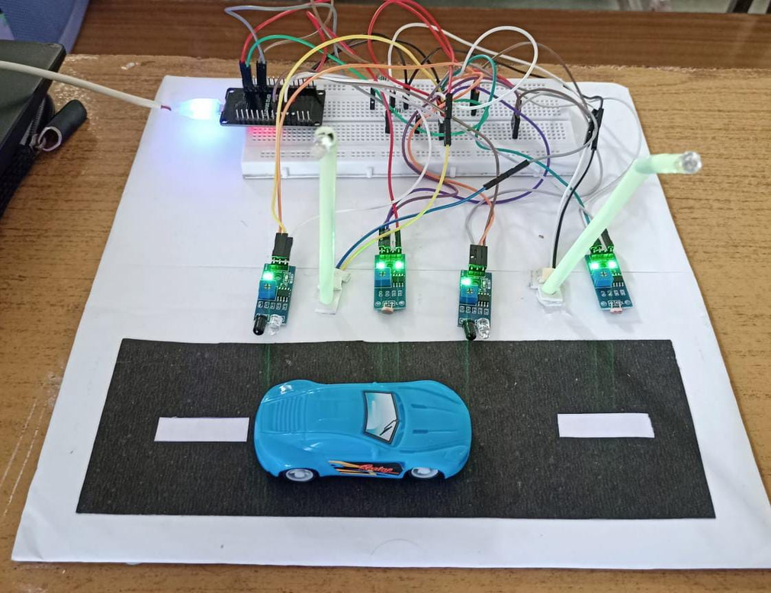
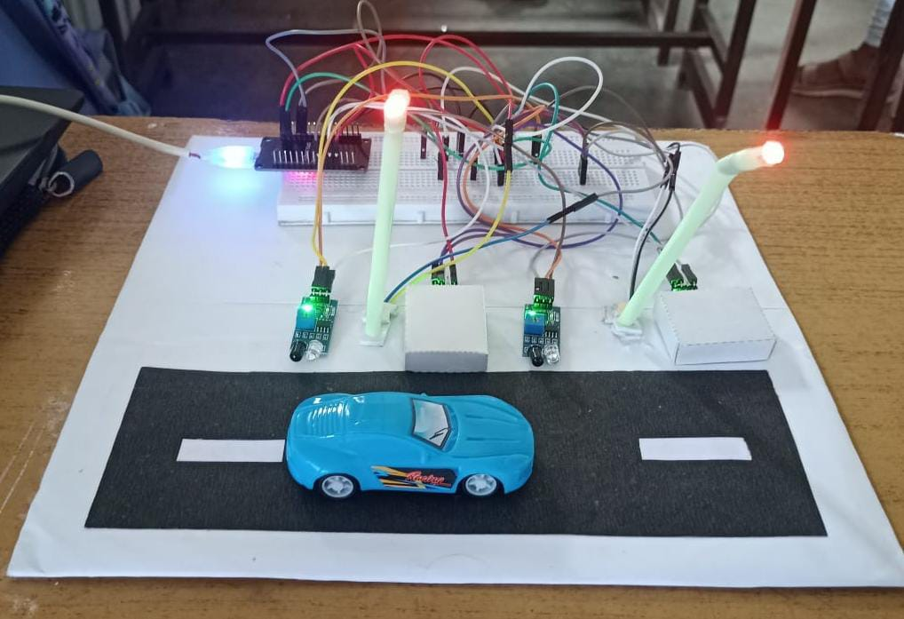
OUTPUT
a)When it’s a day time
a)When it’s dark and motion detected

Slide 10
CONCLUSION
Energy Efficiency: Automated LED control based on light and motion reduces energy use.
Remote Control: Blynk app integration allows easy remote monitoring and control.
Versatility: Supports both automatic and manual modes for user flexibility.
Scalability: Easily expandable for more sensors and lights.

Slide 11
FUTURE ENHANCEMENT
Enhanced Features: Incorporate advanced functionalities like vehicle speed estimation, number plate recognition, and accident detection to bolster safety and transportation efficiency.
Renewable Integration: Integrate renewable energy sources such as solar panels to address energy demands sustainably, reducing reliance on conventional power grids.
ML & AI Integration: Use AI for optimized brightness, usage prediction, and anomaly detection.
Smart City Applications: The project's scope extends beyond street lighting to encompass broader smart city initiatives.

Slide 12

Rehma S & Reshma A
Thank You
LDR SENSOR

